Slide 1
Let’s Talk: INVITATIONS & picture description
Module 2
Lesson 9 class 2

Slide 2
Invitations: vocab review & Speaking activity

Slide 3
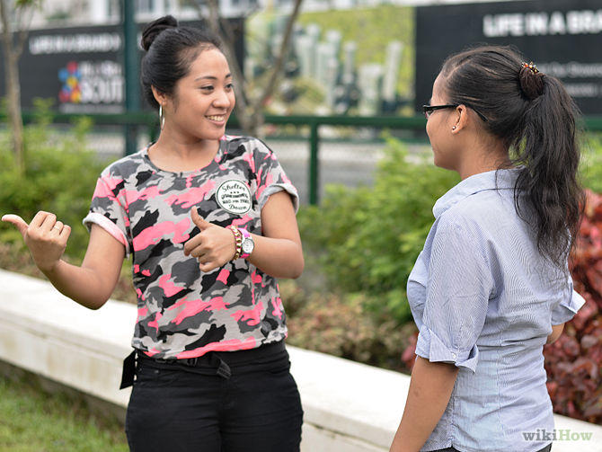
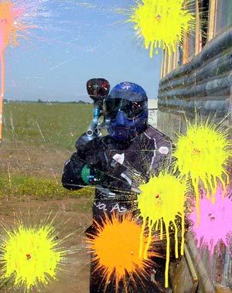
Invitations
Formal
Would you like to go paintballing this weekend?
Informal
Do you want to go paintballing this weekend?
Let’s go paintballing this weekend.
How about going paintballing this weekend?

Slide 4
Accepting (Yes)
Formal
I’d love to. (I would love to)
That would be lovely. (nice, great, fun, etc.)
Informal
Sounds good. (great, awesome, nice*, lovely*, etc.)
Yeah / Ok / Sure

Slide 5
Declining (No)
That sounds really nice, but ________. How about next weekend?
I would love to, but ________.
I’m sorry, but _________.
Maybe some other time.
No, thanks.

Slide 6
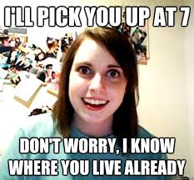
Making plans
Time
When can we meet?
Place
Where can we meet?
Let’s meet at my house at 7 o’clock on Saturday night.
Let’s meet at 7 o’clock on Saturday night at my house .

Slide 7

Invitations: Rejecting and Accepting
Student A: Greet your classmate. Then, choose an activity (from the wheel). Invite Student B to the activity with you.
Student B: Reject the invitation. Give a specific reason. Then, choose another activity and suggest doing that instead (make another invitation).
Student A: Accept Student B’s invitation and ask for details. Perhaps you can ask if another friend or your partner can join you.
Student B + Student A: Discuss any final details. Reach a clear agreement.

Slide 8
Invitations: Rejecting and Accepting
You don’t need to use these exact words like a robot! Paraphrase as needed!
Go to an antiques fair | Have a picnic in the park
Rent a cabin for the weekend | Make vegan burgers to sell them on campus

Slide 9
Invitations: Rejecting and Accepting (EXAMPLE)
Remember:
Student A: Invite.
Student B: Reject. Then Invite to sth else.
St. A: Accept the new invitation.
Sts. A+B: Confirm details.
Student A: Hi Student B! Tomorrow should be a beautiful day. Would you like to go to the antiques fair in Plaza Peru?
Student B: Sorry, but I’m not really into that sort of thing. I don’t like to buy stuff like that. It just sits around taking up space.
Student A: Oh, that’s too bad, but maybe I can ask Tomás to come with me.
Student B: Yeah, he might be interested… But anyway, what about the next long weekend? Would you like to rent a cabin and get out of the city? You could bring your daughter.
Student A: That would be wonderful. …
What else do they need to discuss?
Time
Place to meet
Price?
Transport?
… or something else?

Slide 10
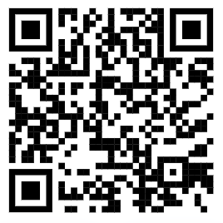
Making invitations
Scan the code
Use the Wheel to choose an activity and make an invitation.
Remember:
Student A: Invite.
Student B: Reject. Then Invite to sth else.
St. A: Accept the new invitation.
Sts. A+B: Confirm details.

Slide 11
Picture description
Interview practice

Slide 12
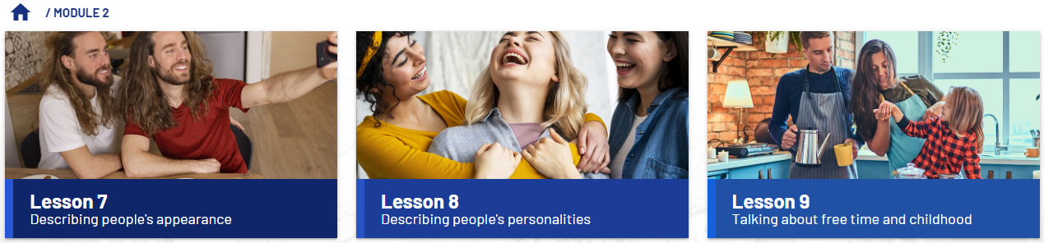
Topics of lessons 7-9
Which topics are important for picture description?
Describing physical appearance Asking questions about physical appearance Future forms will and be going to | Describing personality Using comparatives and superlatives Using adjectives that end in –ed and -ing | Free time activities Likes and dislikes Weather Making and responding to invitations Childhood memories used to and would to-infinitives and gerunds Agreeing with so and neither

Slide 13
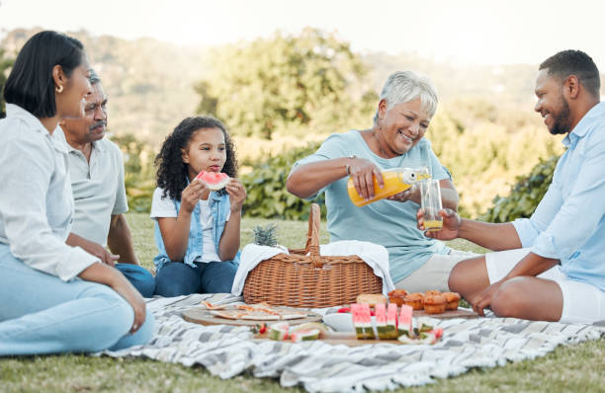
Tips for picture description
Begin with a general description of what you see
How many people are there?
Where are they? What are they doing?
Continue with the topics from the lessons
Physical description of the person or people
Free time activities
The weather
Finish by expanding on the description
Can you compare the people or activities?
Is there evidence of their personality?
Can you predict what is going to happen next?
Did you use to do the same thing?
Do you like being in this place / doing this activity?
In this picture, I can see five people. They are having a picnic at a park.
The young girl has long, curly dark brown hair, but the older woman has short white hair. The older man has a moustache and the younger man has a beard. It’s sunny and warm.
I think everybody in the picture is kind and outgoing because they are all happy spending time together. Personally, I don’t enjoy eating outside. My family never used to go on picnics when I was a kid.

Slide 14
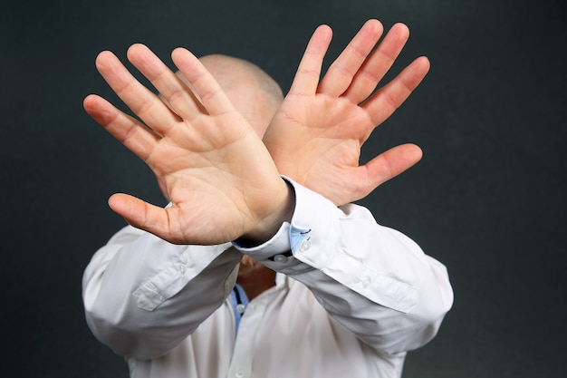
Things not to do
Don’t focus on personal information, daily activities or clothing (that’s module 1).
Don’t repeat yourself – for example, if there are four blond people in the picture, don’t say it four times!
Don’t just list vocabulary words. Always use complete sentences in a coherent way.
Don’t forget basic sentence patterns – for example, present continuous.
Don’t say persons, peoples, mens, childs, childrens, womans,…
Use the proper plurals: people, men/guys, women/ladies/girls, children/kids

Slide 15

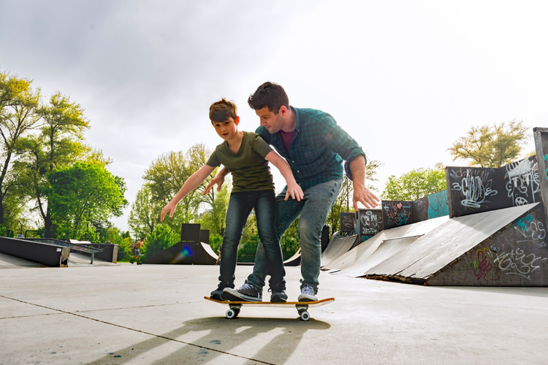
Practice with a timer: Remember: Appearance, free-time activities, weather
START
FINISH

Slide 16
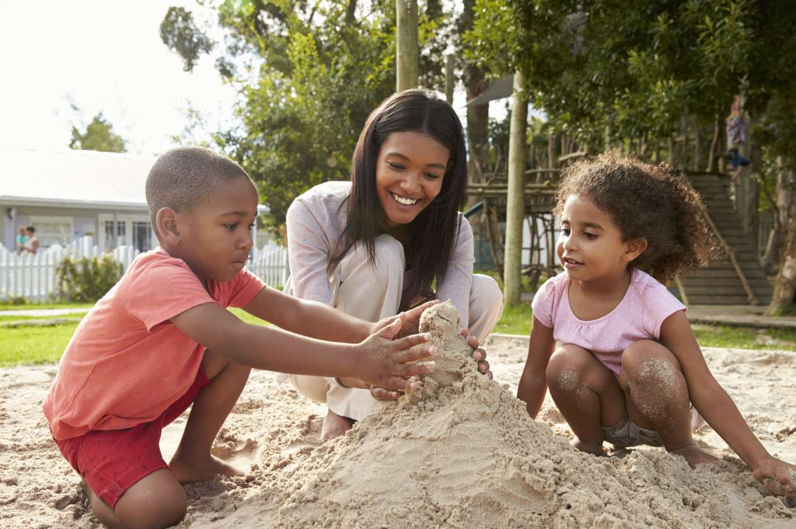
Practice with a timer: Remember: Appearance, free-time activities, weather
START
FINISH
TIME’S
UP!!

Slide 17
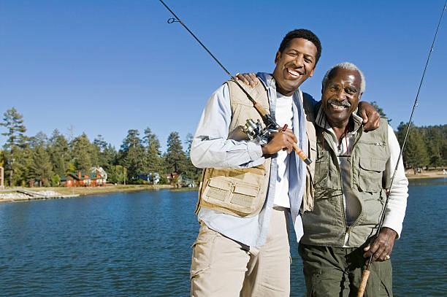
Practice with a timer: Remember: Appearance, free-time activities, weather
START
FINISH
TIME’S
UP!!

Slide 18
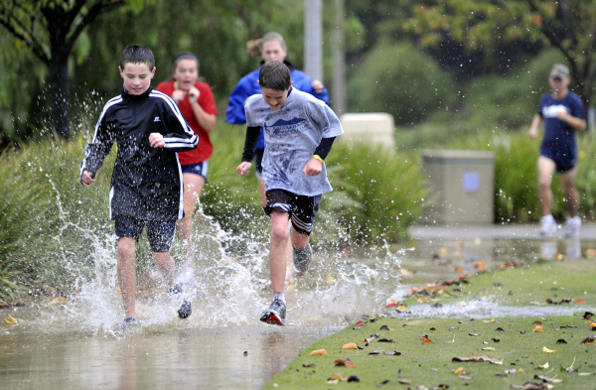
Practice with a timer: Remember: Appearance, free-time activities, weather
START
FINISH
TIME’S
UP!!

Slide 19
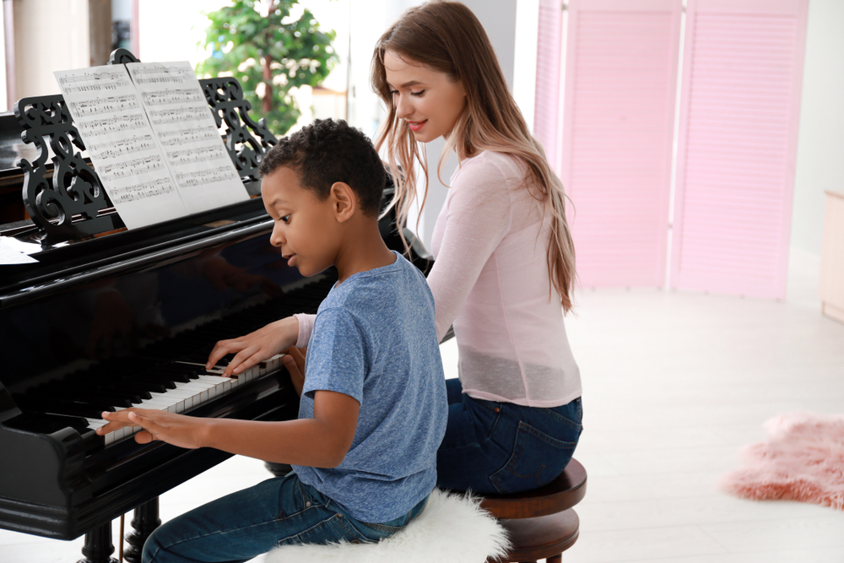
Practice with a timer: Remember: Appearance, free-time activities, weather
START
FINISH
TIME’S
UP!!

Slide 20
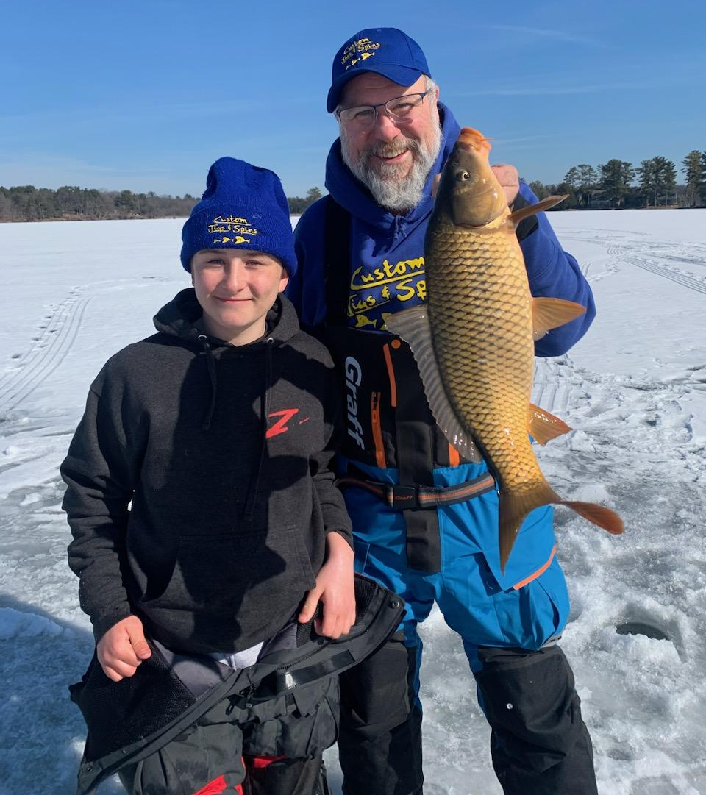
Practice with a timer: Remember: Appearance, free-time activities, weather
START
FINISH
TIME’S
UP!!

Slide 21
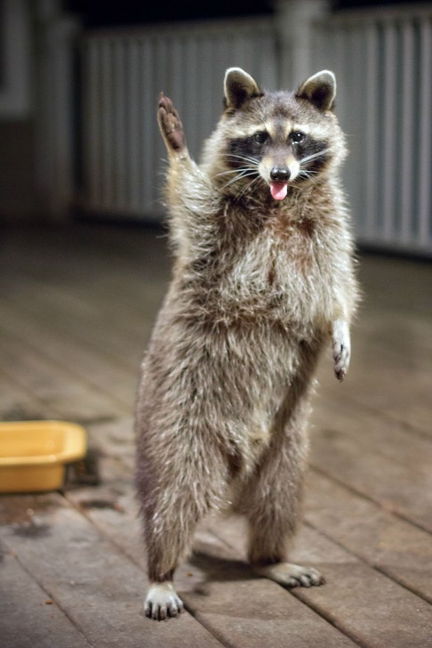
Invitations: VOCAB REVIEW
INVITING
Would you like to go to…?
(Do you) Want to go to…?
How about going to…?
What about going to…?
Let’s go to… !
Why don’t we go to…?
What would say if we went to…?
JOINING OTHER PEOPLE
Can I tag along with you guys?
Do you mind if my mom comes too?
Would you mind if Matías joined us?

Slide 22
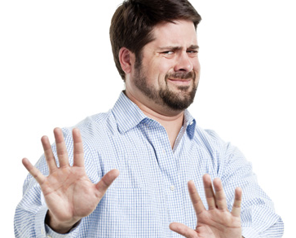
Invitations: Accepting and Rejecting
ACCEPTING
Sure, I’d love to.
(That) sounds fun / great / wonderful / fantastic.
That’s a great idea.
Thanks for thinking of me. I’ll put it in my calendar.
I’m in. / I’m down. / I’m game. / I’m up for it.
Great, let’s do it!
… (any other natural phrase!)
REMEMBER TO DISCUSS THE TIME, PLACE, AND ANY OTHER DETAILS AFTER YOU ACCEPT THE INVITE
REJECTING
I’m sorry, I can’t.
I’m afraid it won’t be possible.
I’d love to, but…
Sorry, but I’m really not into that sort of thing.
Thanks for asking, but…

